Slide 1

Visual Design
Program and Career Orientation

Slide 2
At the end of this day, you can
Explain the structure of the entire first year
01
Choose a CSS path
02
Start preparing for the pitch
03

Slide 3
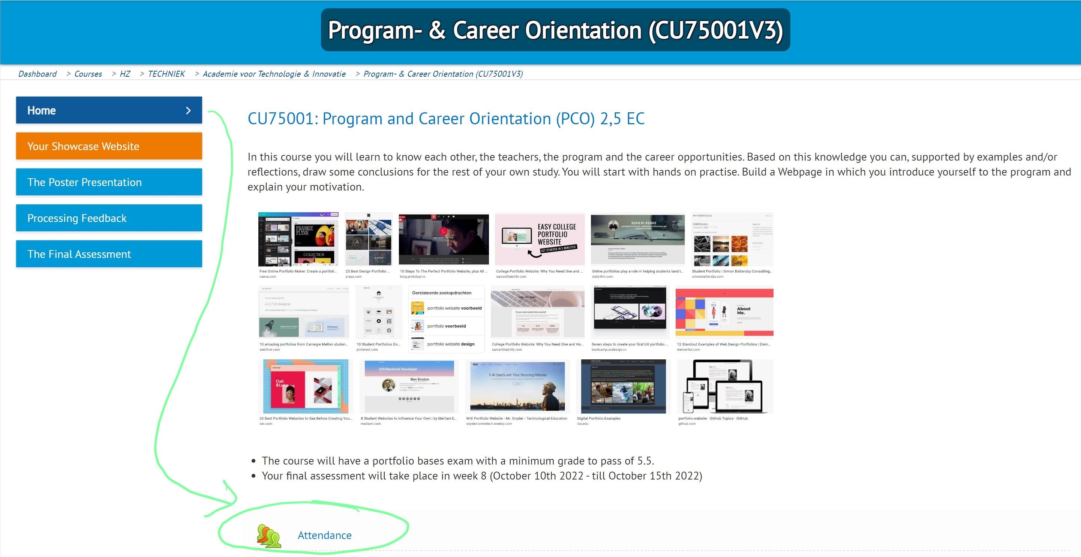
Attendance!
Notes:
For better or for worse, you are in an adult education program, and we will treat you as such.
For the first two weeks we ask you to register your attendance online. You have to do this yourself via HZ Learn
Your attendance and study progress is your own responsibility
We offer help where we can, but ask if you need more!

Slide 4
Assignment specification
Five pages minimum
Home
Profile
Dashboard
FAQ
Blog (with sub-pages)

Slide 5

Dashboard
Study monitor

Slide 6
Study monitor
Big HTML table (or grid system)
Contains all quartiles
Contains all courses for this year
Contains the EC per course
Contains all exams per course
Contains all grades per course
Shows the progress towards your NBSA
Notes:
These are the requirements for the study monitor in the dashboard. Let students open the assignment specification, and check if this is complete
Note: these are all requirements that are related to the table structure. So, we’ve translated the requirements in order to be able to design the table structure

Slide 7

Let’s do some design
Given the requirements
The page requires a <table>
A table consists of columns and rows
If you look at what information is required:
How many columns (vertical) should our table have?
How many rows (horizontal) should our table have?

Slide 8
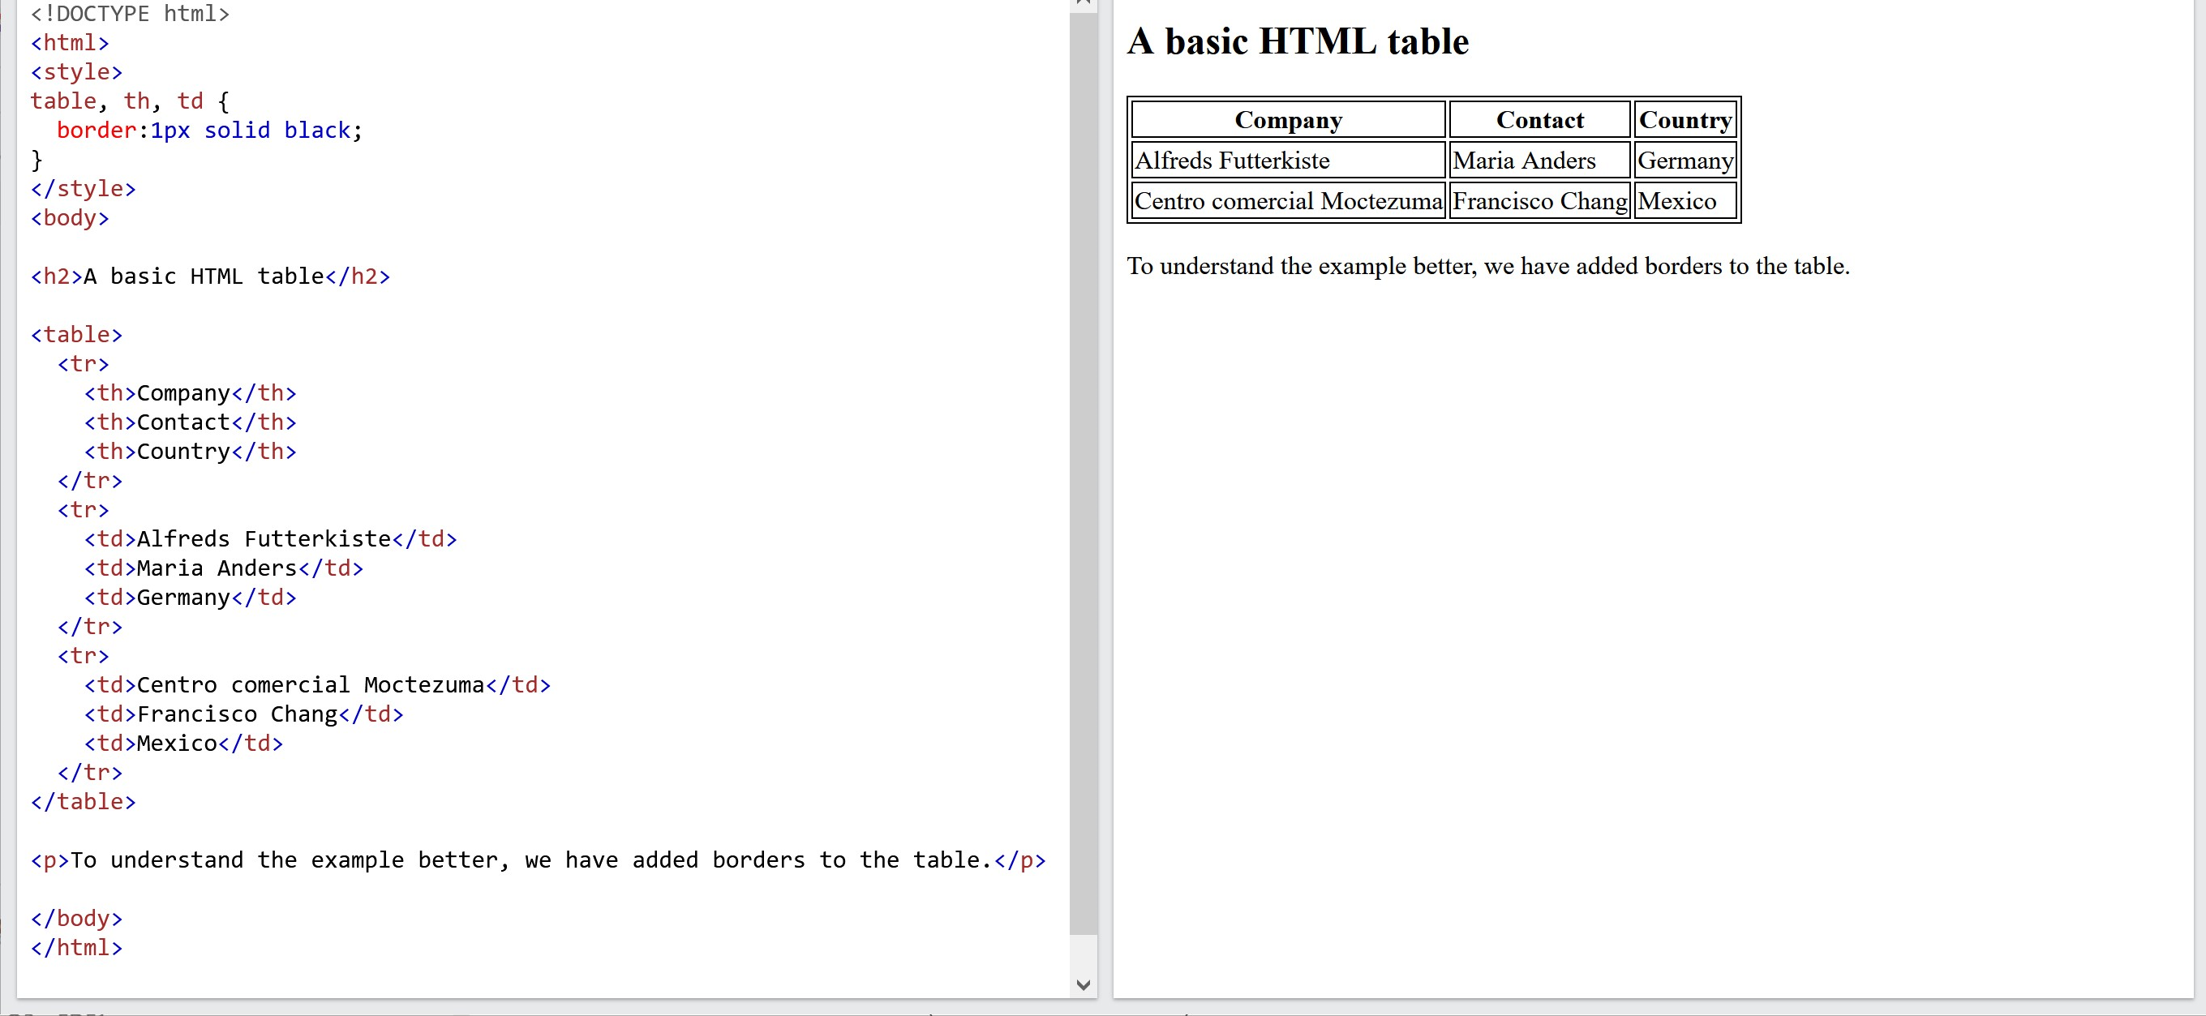
HTML tables be like
Notes:
https://www.w3schools.com/html/tryit.asp?filename=tryhtml_table3
Important sections to mention:
A table consists of (nested) columns and rows
A row is a <tr> element
Columns are represented as <td> elements inside each row (and are actually cells then)
First row contains <th> elements as the table header

Slide 9
Let’s do some design
Given the requirements
The page requires a <table>
A table consists of columns and rows
If you look at what information is required:
How many columns (vertical) should our table have?
How many rows (horizontal) should our table have?

Slide 10
Quartile | Course | EC | Exam | Grade

Slide 11
Let’s do some design
Given the requirements
The page requires a <table>
A table consists of columns and rows
If you look at what information is required:
How many columns (vertical) should our table have?
How many rows (horizontal) should our table have?

Slide 12
Quartile | Course | EC | Exam | Grade
1
2
3
4
Notes:
Something like this? Check the CER: Uitvoeringsregeling naam opleiding (hz.nl)
Walk through the CER and make aware that:
Grades belong to exams
Exams are grouped in courses
Courses are (kinda) grouped in quartiles (at least, the exams)

Slide 13
Quartile | Course | EC | Exam | Grade
1 | First course | 5 | Written | 5,9
 | Second course | 5 | Case study | 7,2
 |  |  | Assessment | 5,8
2 | … | … | … | …
3 | … | … | … | …
4 | … | … | … | …
Notes:
So, we need something like this, where some parts of the table are structured differently.
We see that some of the cells are ‘merged’ into one cell, or that one cell is ‘spanning’ across multiple rows
How can we do that?

Slide 14
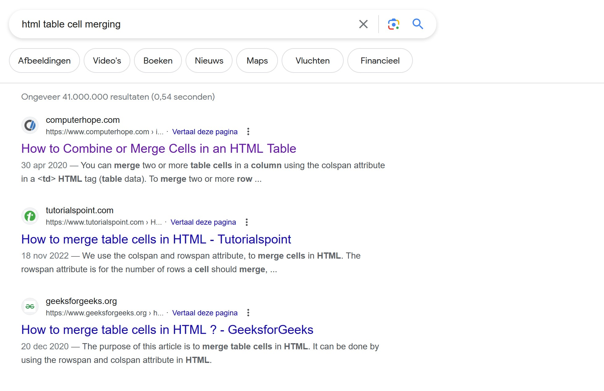
Solution: “html table cell merging”

Slide 15
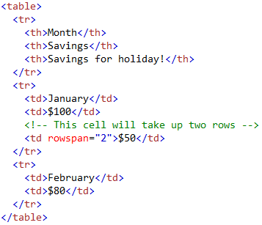
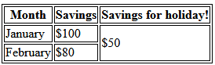
No third <td> here

Slide 16

Mission accomplished
You know all propaedeutic phase courses
You know the exams and credits per course
Let’s build that table
When done:
Think about the styling of the table
Think about visualizing completeness
Don’t forget to hand in your visual designs before Checkpoint starts
Notes:
Refer to the skills lab assignment on Learn (notion)
May work individually or in groups. Prefer in groups, so you can discuss opinions about designs

